Slide 1
American Housing Survey:
Preliminary Findings from the
2009 New Orleans Metropolitan Survey
Wendy Chi
Economist
Housing and Demographic Analysis Division
Office of Policy Development and Research

Slide 2
2009 New Orleans Metropolitan AHS
New Orleans metropolitan area includes: Jefferson, Orleans with New Orleans, Plaquemimes, St Bernard, St James, St John the Baptist, St Tammany
Housing stock in the New Orleans metropolitan area was 587,000 units in 2004 and dropped to 512,000 units in 2009
Nearly 75,000 housing units in the New Orleans metro area were lost due to Hurricane Katrina (nearly 13 percent of its housing stock) – prior to Katrina, 52% of these destroyed units were owner-occupied and 48% were renter-occupied
In 2009, over 72,000 units remained vacant in the New Orleans metropolitan area – the 14.2% vacancy rate was well above the 2009 national vacancy rate of 10.5%
The New Orleans housing stock is now younger: median year built is 1972 compared to 1960 prior to Katrina

Slide 3
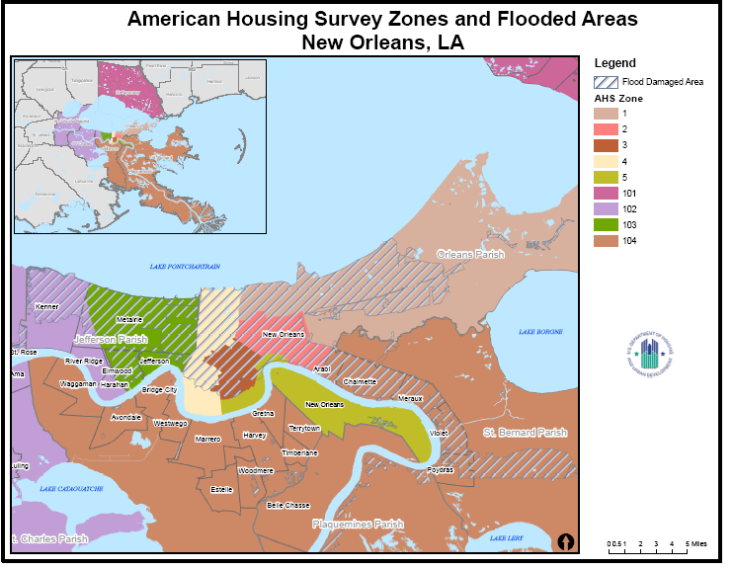

Slide 4
Katrina Made New Orleans Housing More Expensive
Median Monthly Housing Costs | All Occupied Units | Owner Occupied Units | Renter Occupied Units
2004 New Orleans metropolitan area | $662 | $626 | $689
2009 New Orleans metropolitan area | $882 | $896 | $876
2009 National | $922 | $1,051 | $784
Source: 2004 New Orleans Metropolitan AHS, 2009 New Orleans Metropolitan AHS, 2009 national AHS
Note: 2004 median costs are adjusted for inflation and converted to 2009 dollars.

Slide 5
Owner Occupied | 2004 |  | 2009
Cost ($) | Units | Percentage | Units | Percentage
All | 323,300 | 100.0 | 292,000 | 100.0
No Cash Rent | NA | NA | NA | NA
Less than 100 | 3,400 | 1.0 | 1,000 | 0.3
100-199 | 30,200 | 9.3 | 6,000 | 2.1
200-249 | 24,500 | 7.6 | 6,700 | 2.3
250-299 | 23,700 | 7.3 | 10,900 | 3.7
300-349 | 20,600 | 6.4 | 13,800 | 4.7
350-399 | 15,000 | 4.7 | 11,700 | 4.0
400-449 | 13,100 | 4.1 | 15,200 | 5.2
450-499 | 8,800 | 2.7 | 15,600 | 5.3
500-599 | 17,700 | 5.5 | 19,900 | 6.8
600-699 | 17,700 | 5.5 | 19,700 | 6.7
700-799 | 15,700 | 4.8 | 13,600 | 4.7
800-999 | 34,400 | 10.6 | 30,000 | 10.3
1,000-1,249 | 32,600 | 10.1 | 35,700 | 12.2
1,250-1,499 | 22,500 | 7.0 | 24,900 | 8.5
1,500 or more | 43,400 | 13.4 | 67,200 | 23.0

Slide 6
Renter Occupied | 2004 |  | 2009
Cost ($) | Units | Percentage | Units | Percentage
All | 174,900 | 100.0 | 142,600 | 100.0
No Cash Rent | 10,500 | 6.0 | 9,400 | 6.6
Less than 100 | 1,700 | 1.0 | 848 | 0.6
100-199 | 5,500 | 3.1 | 2,000 | 1.4
200-249 | 2,700 | 1.5 | 2,100 | 1.5
250-299 | 2,300 | 1.3 | 2,900 | 2.0
300-349 | 2,700 | 1.6 | 1,200 | 0.8
350-399 | 5,000 | 2.9 | 2,800 | 2.0
400-449 | 6,000 | 3.4 | 2,700 | 1.9
450-499 | 7,100 | 4.1 | 3,500 | 2.5
500-599 | 23,400 | 13.4 | 9,100 | 6.4
600-699 | 29,100 | 16.7 | 12,600 | 8.8
700-799 | 25,700 | 14.7 | 14,500 | 0.2
800-999 | 29,900 | 17.1 | 31,700 | 22.2
1,000-1,249 | 10,600 | 6.1 | 26,300 | 18.5
1,250-1,499 | 6,100 | 3.5 | 9,900 | 6.9
1,500 or more | 6,600 | 3.8 | 11,100 | 7.8

Slide 7
Katrina and Recovery Induced Many Moves
# of residences since Katrina | # of Units | Percentage
1 | 58,600 | 19.5
2 | 94,900 | 31.5
3 | 76,500 | 25.4
4 | 37,100 | 12.3
5 | 16,600 | 5.5
6 | 7,600 | 2.5
7 | 3,300 | 1.1
8+ | 3,600 | 1.2
Source: 2009 New Orleans Metropolitan AHS

Slide 8
Damaged Housing Units
Of the owner-occupied units, the 2009 New Orleans metropolitan AHS reveals:
Over 252,000 units were damaged due to Hurricane Katrina
As of 2009, over 90% of these damaged units have undergone repairs
Nearly 11,000 housing units were severely damaged, and nearly 9,700 of these units were rebuilt
More than 18,000 homeowners either have or intend to elevate their homes due to Katrina

Slide 9
Funds for Rebuilding and Repair
Nearly 74% of the damaged units received insurance or financial aid to rebuild or repair the home
Financial Aid Source | Units | Percentage
Homeowner’s insurance | 160,300 | 86.0
Federal flood insurance | 45,900 | 24.7
Federal financial aid | 16,700 | 9.0
Private or charitable aid | 4,700 | 2.5
State financial aid | 1,100 | 0.6
Source: 2009 New Orleans Metropolitan AHS

Slide 10
Repairs of the Damaged Owner-Occupied Units
Repairs were costly – 50% of the homeowners spent $5000 or more on repairs
Nearly 20% of the homeowners performed most of the repairs and alterations on their own
Type of Repair | Units | Percentage
Roof repairs | 112,300 | 56.9
Room(s) added | 17,000 | 8.7
Electrical wiring | 6,100 | 3.1
Windows | 5,500 | 2.8
Fencing or wall | 4,200 | 2.1
Deck added | 4,200 | 2.1
Central Air Condition | 3,900 | 2.0
Source: 2009 New Orleans Metropolitan AHS

Slide 11
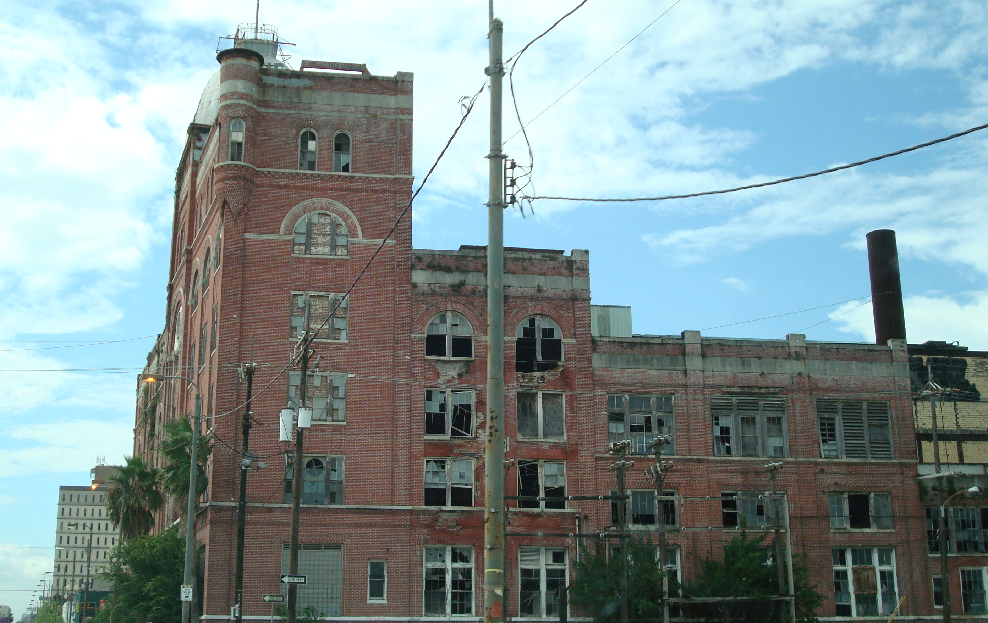
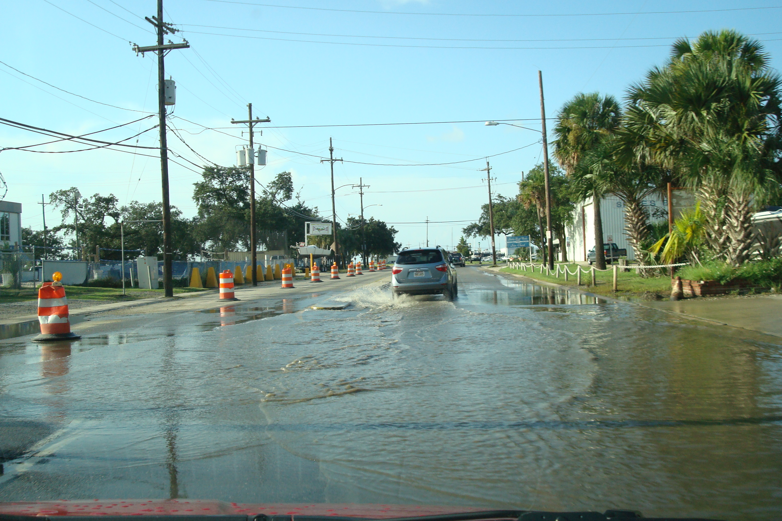
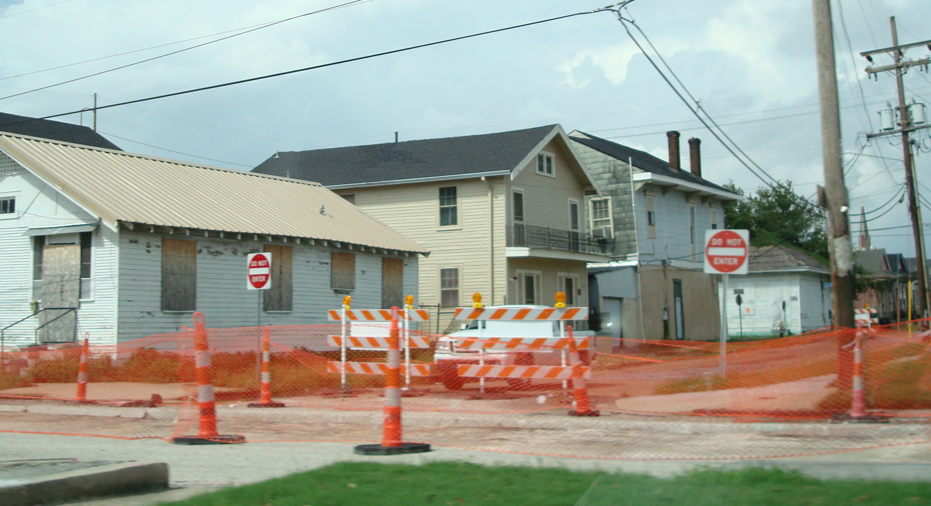
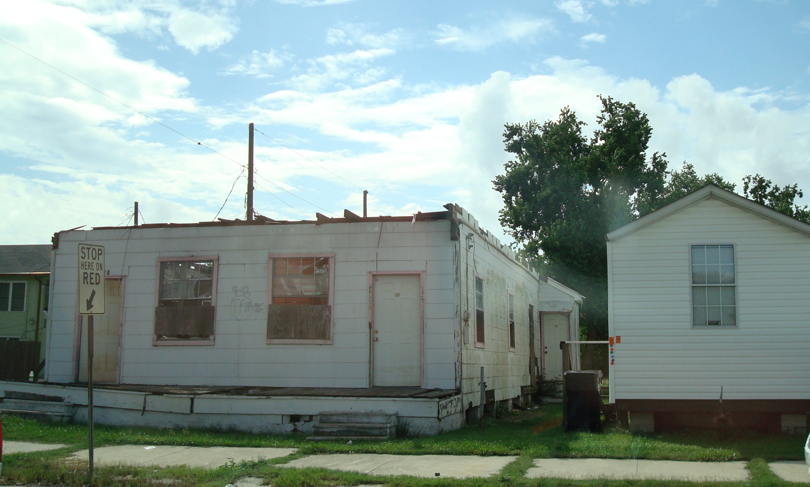
Today Reconstruction Efforts Are in Progress

Slide 12

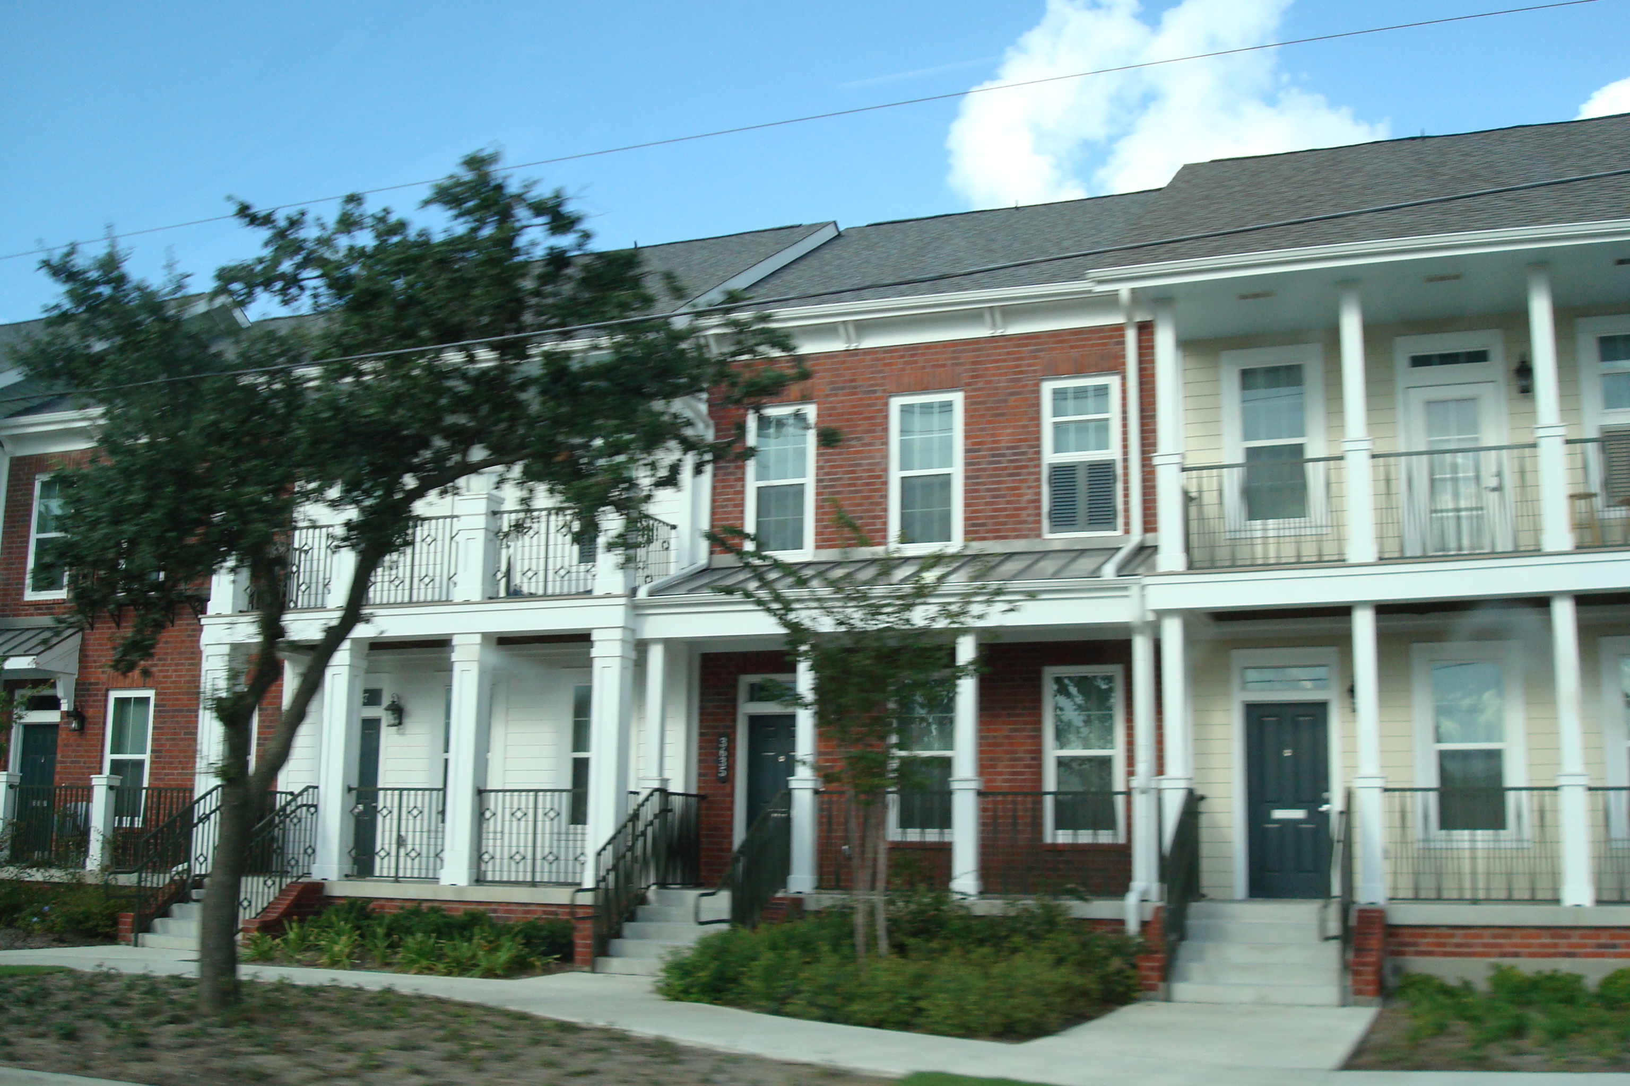
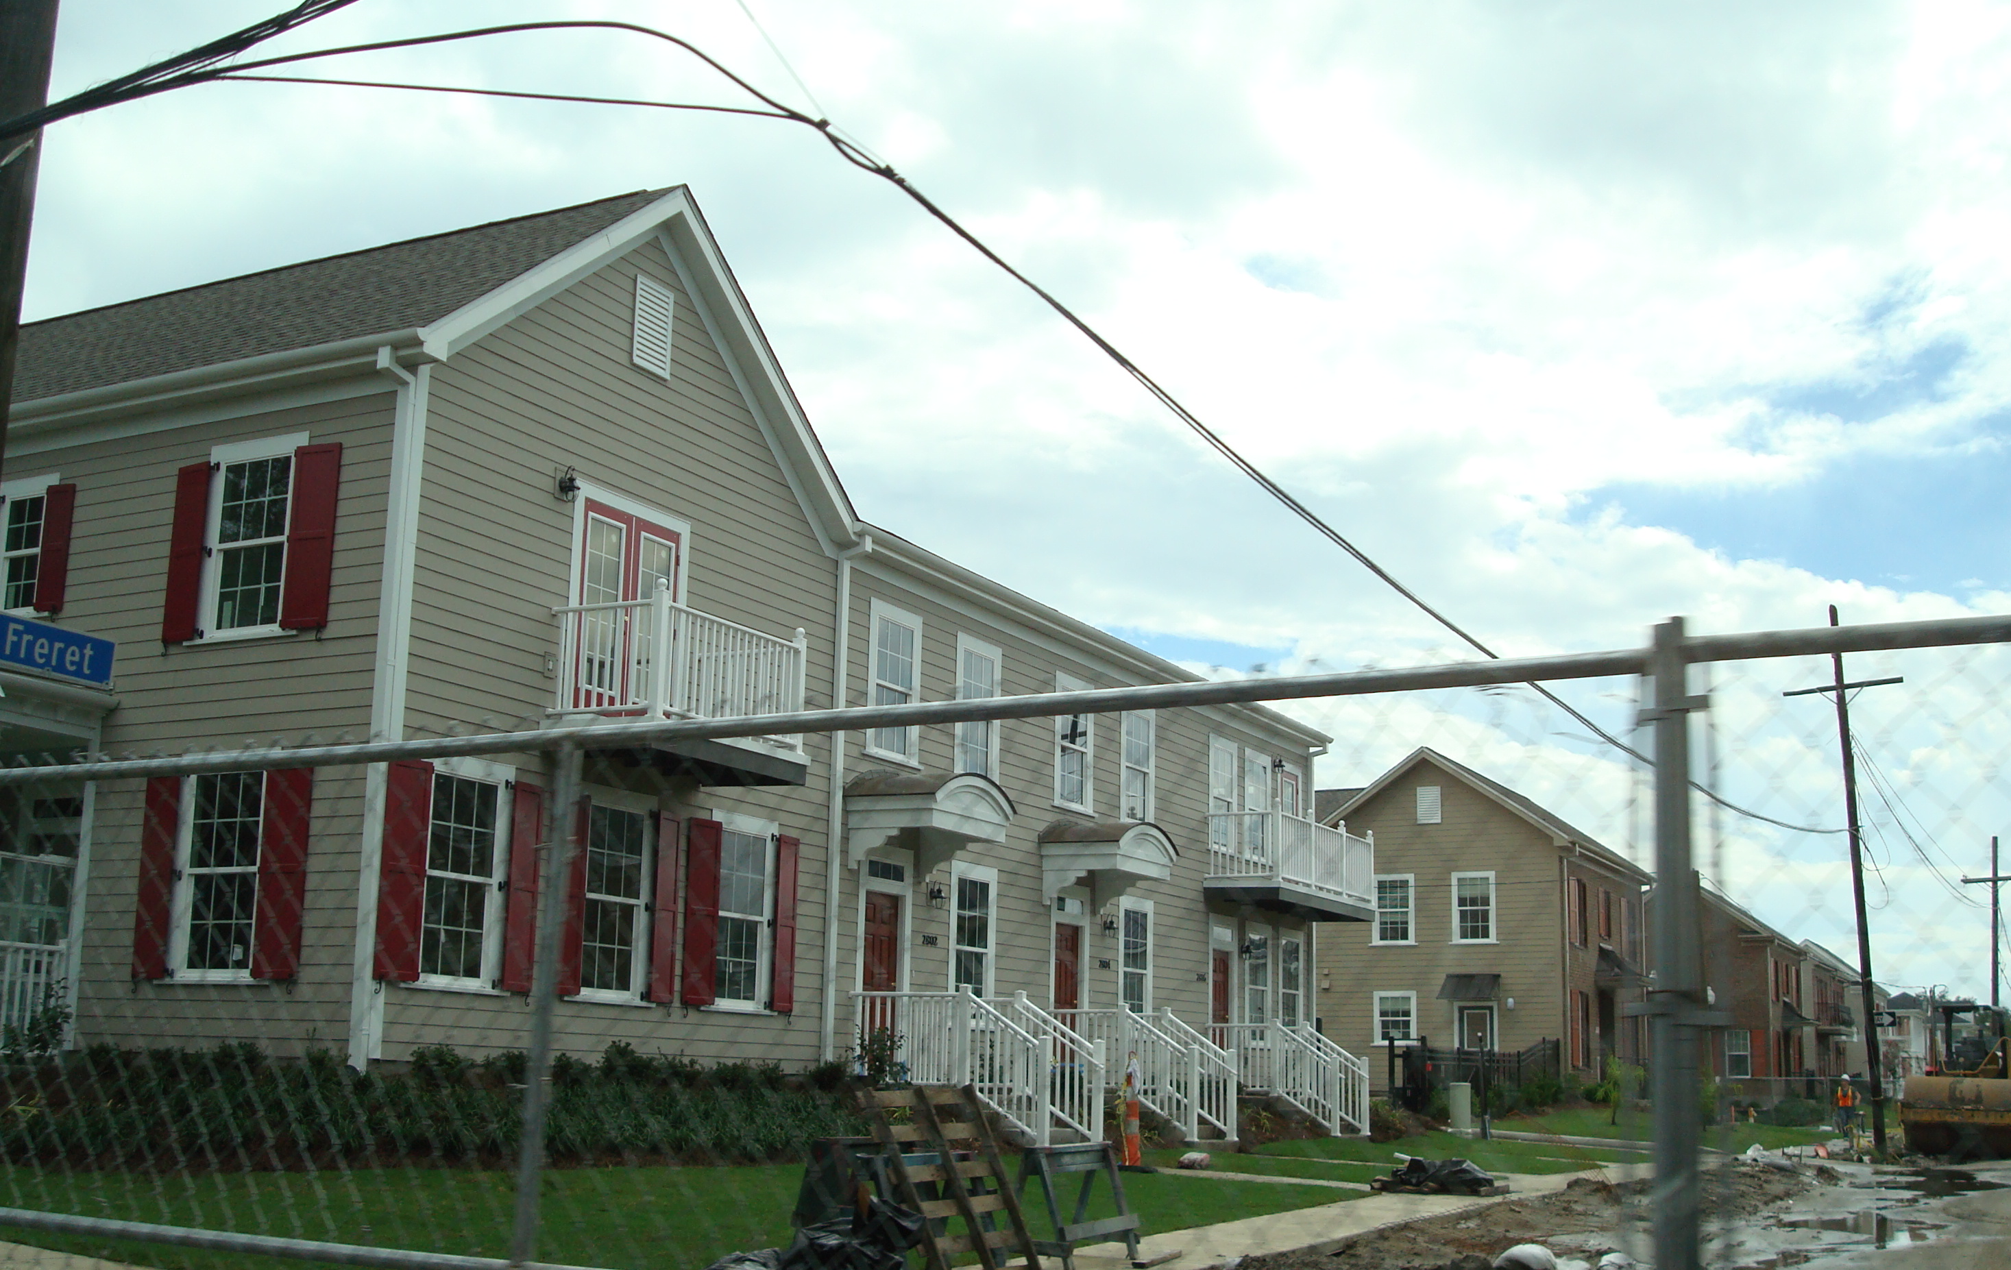
New Orleans Today
Suburbs: substantial redevelopment of public housing sites
Downtown: mostly recovered

Slide 13
2009 New Orleans Metropolitan AHS Data
Release date: September 10, 2010
Data will be posted on www.huduser.org
Questions contact:
Housing and Demographic Analysis Division
Email: Wendy.Y.Chi@hud.gov
Phone: 202.402.6534

